Slide 1
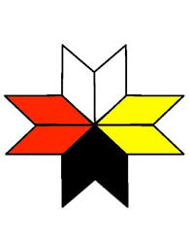
Fostering Socially
Just Education Initiatives
Among the Mi’kmaq and Settlers
Elder Joe Michael
& Margaret JA Knickle
MSVU PhD student
October 2018

Slide 2
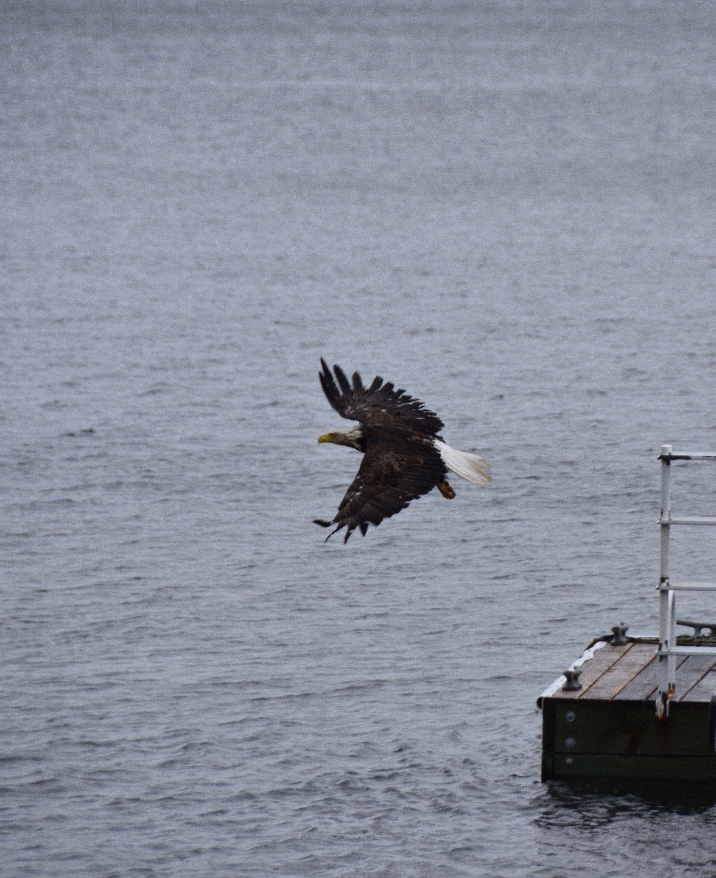
Kwe’
PJILA’SI!

Slide 3
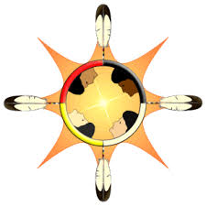
INTRODUCTION
A personal account of my journey to rebuild relations between the Mi’kmaq and myself.
This process started me on a path of unpacking my personal ancestry, which is very Eurocentric and colonial based.
Example for how to build relationships and support the local Mi’kmaq community.
This study provides a tool for educators interested in beginning the decolonizing process for themselves, their students, classrooms, school, community and so forth.

Slide 4
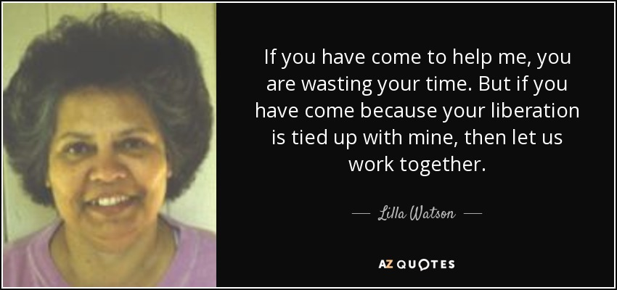

Slide 5
Mahone Bay Museum
TRC Calls to Action 62.1
Two Eyed Seeing
Mi’kmaw Worldviews
Unsettling the Settler
SOCIALLY JUST PEDAGOGY
Book Proposal with Elder
N.S. Treaty Education
Indigenous Storywork
Presenting with Elder
Indigenous Research Methodologies
Relationship
Indigenous Allyship
Atlantic Canadian History

Slide 6

Indigenous Storywork and allyship
Importance of practicing Indigenous Storywork and Indigenous Allyship as methodology in research
Indigenous storywork used to open the door for non-Indigenous people to become allies with Mi’kmaq by “restorying,” or retelling from an Mi’kmaw perspective, the historical narratives that have dominated the official view of the region’s history.
This technique introduced decolonizing space that made room for the inclusion of the history and narrative of the L’nu or Mi’kmaw in Mi’kma’ki.

Slide 7
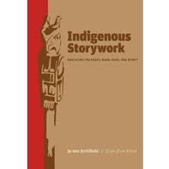
What is Indigenous storywork?
Indigenous Storywork: Educating the Heart, Mind, Body and Spirit by JoAnn Archibald, Q’um Q’um Xiiem (2008)
Use Indigenous storywork principles to disrupt settler’s ontology, axiology, methodology & epistemology through their historical colonial narrative
Create space for more socially just narratives to emerge between the Mi’kmaq of Mi’kma’ki and settlers
Interrelatedness
Synergy
Holism
Responsibility
Reverence
Respect
Reciprocity

Slide 8
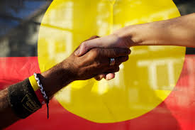
What is an Indigenous ally?
Build genuine relationships and friendship
Recognizing one’s settler privilege
Be informed about the historical, socio-political context that frames our interactions with the Mi’kmaq
Not your identity but it is an action you take
Recognize Mi’kmaw leaders and respect their authority
Practice active listening
Work in solidarity for change
Practicing “Msit No’Kmaq” “All My Relations”

Slide 9
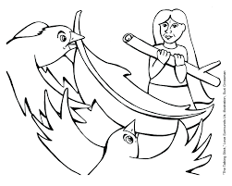
Talking CIRCLE and Discussion

Slide 10
References
Archibald, J. A. (2008). Indigenous storywork: Educating the heart, mind, body, and spirit. UBC press.
Battiste, M. A. (Ed.). (2016). Visioning a Mi'kmaw Humanities: Indigenizing the Academy. Cape Breton University Press.
Battiste, M. (Ed.). (2016). Living Treaties: Narrating Mi'kmaw Treaty Relations. Cape Breton University Press.
Battiste, M. (2013). Decolonizing education: Nourishing the learning spirit. UBC Press.
Bishop, A. (2002). Becoming an ally: Breaking the cycle of oppression in people. London: Zed Books.
Bartlett, C., Marshall, M., & Marshall, A. (2012). Two-eyed seeing and other lessons learned within a co-learning journey of bringing together Indigenous and mainstream knowledges and ways of knowing. Journal of Environmental Studies and Sciences, 2(4), 331-340.
Regan, P. (2010). Unsettling the Setters within: Indian residential school, truth telling, and reconciliation in Canada. Toronto. UBC Press.
Smith, L. T. (2013). Decolonizing methodologies: Research and indigenous peoples. Zed Books Ltd.
Vowel, C. (2016). Indigenous writes: A guide to First Nations, Métis, and Inuit issues in Canada. Portage & Main Press.
Wilson, S. (2008). Research is ceremony: Indigenous research methods. Halifax: Fernwood.
Younging, G. (2018). Elements of Indigenous Style: A Guide for Writing by and about Indigenous Peoples. Brush Education.

