Slide 1
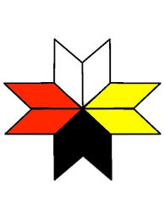
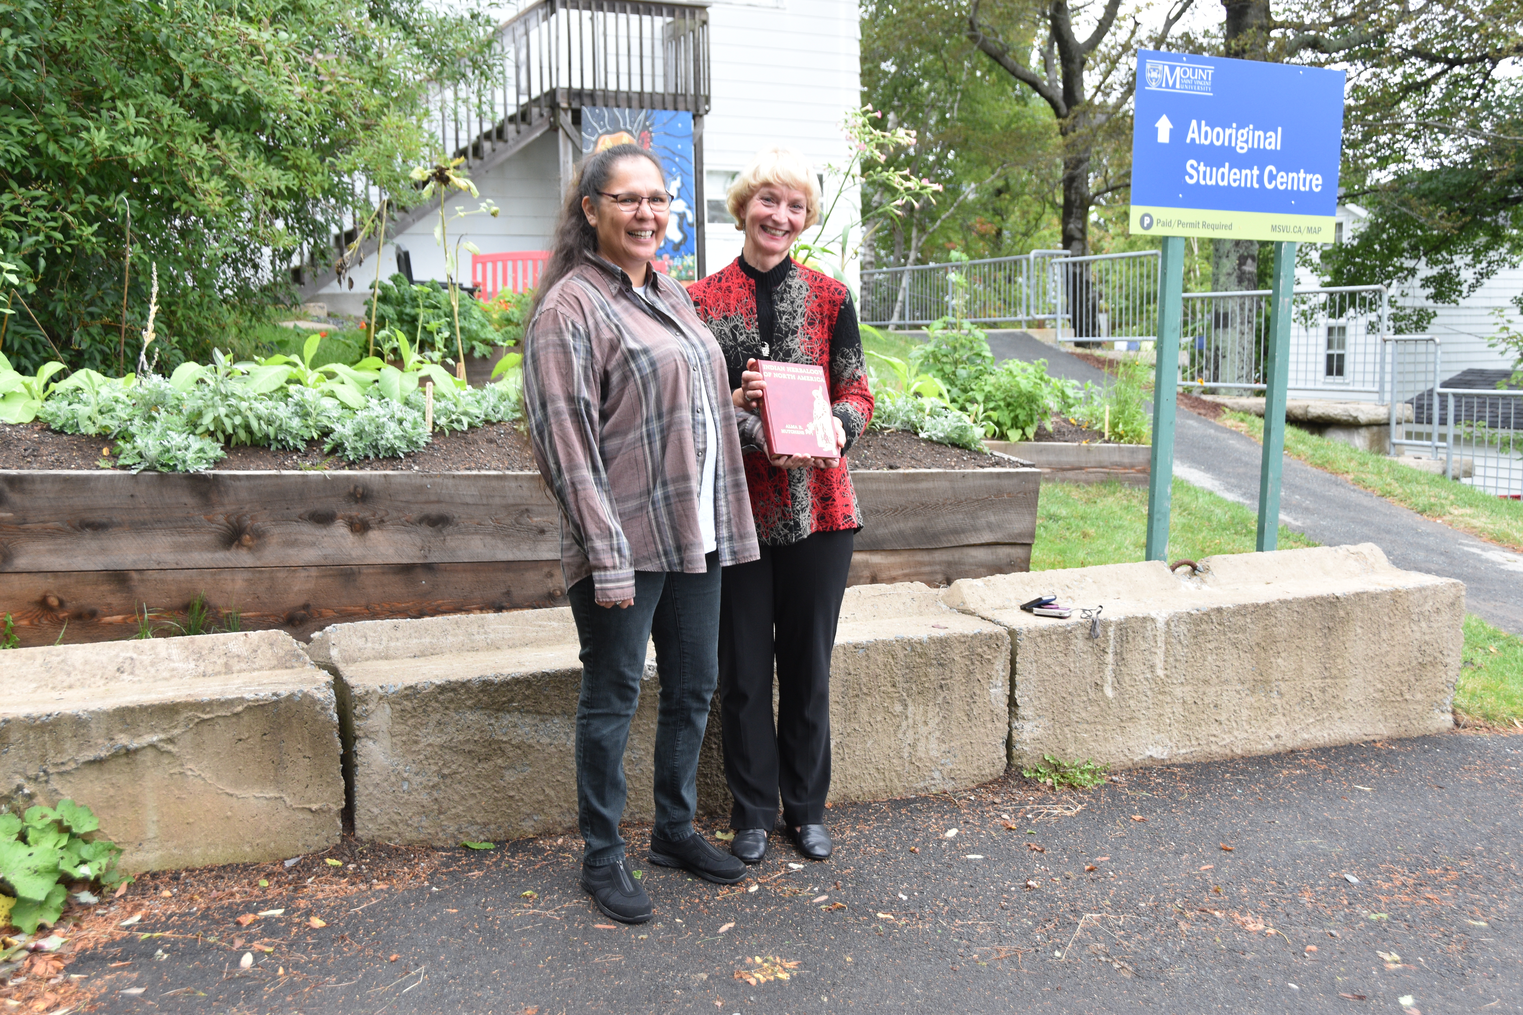
“Mi’kmaw Community and Knowledge Garden”
Building Relationship through Experiential Learning and Scholarship at Mount Saint Vincent University
Elder Joe Michael & Margaret JA Knickle (MJ)
October 20, 2018

Slide 2
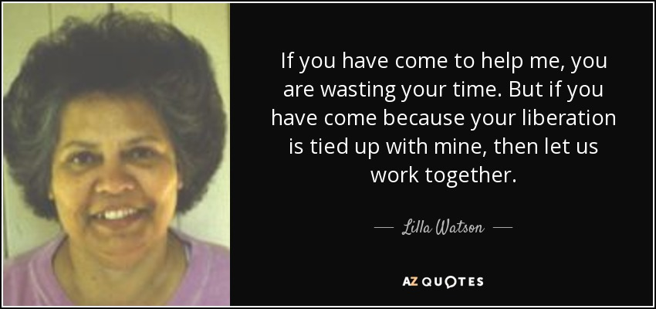

Slide 3
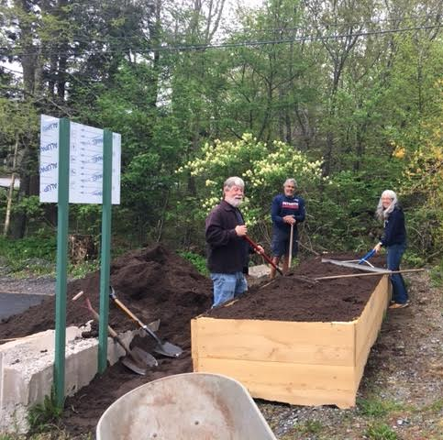
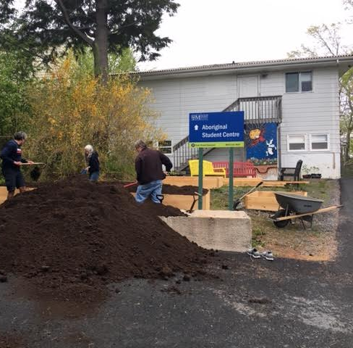
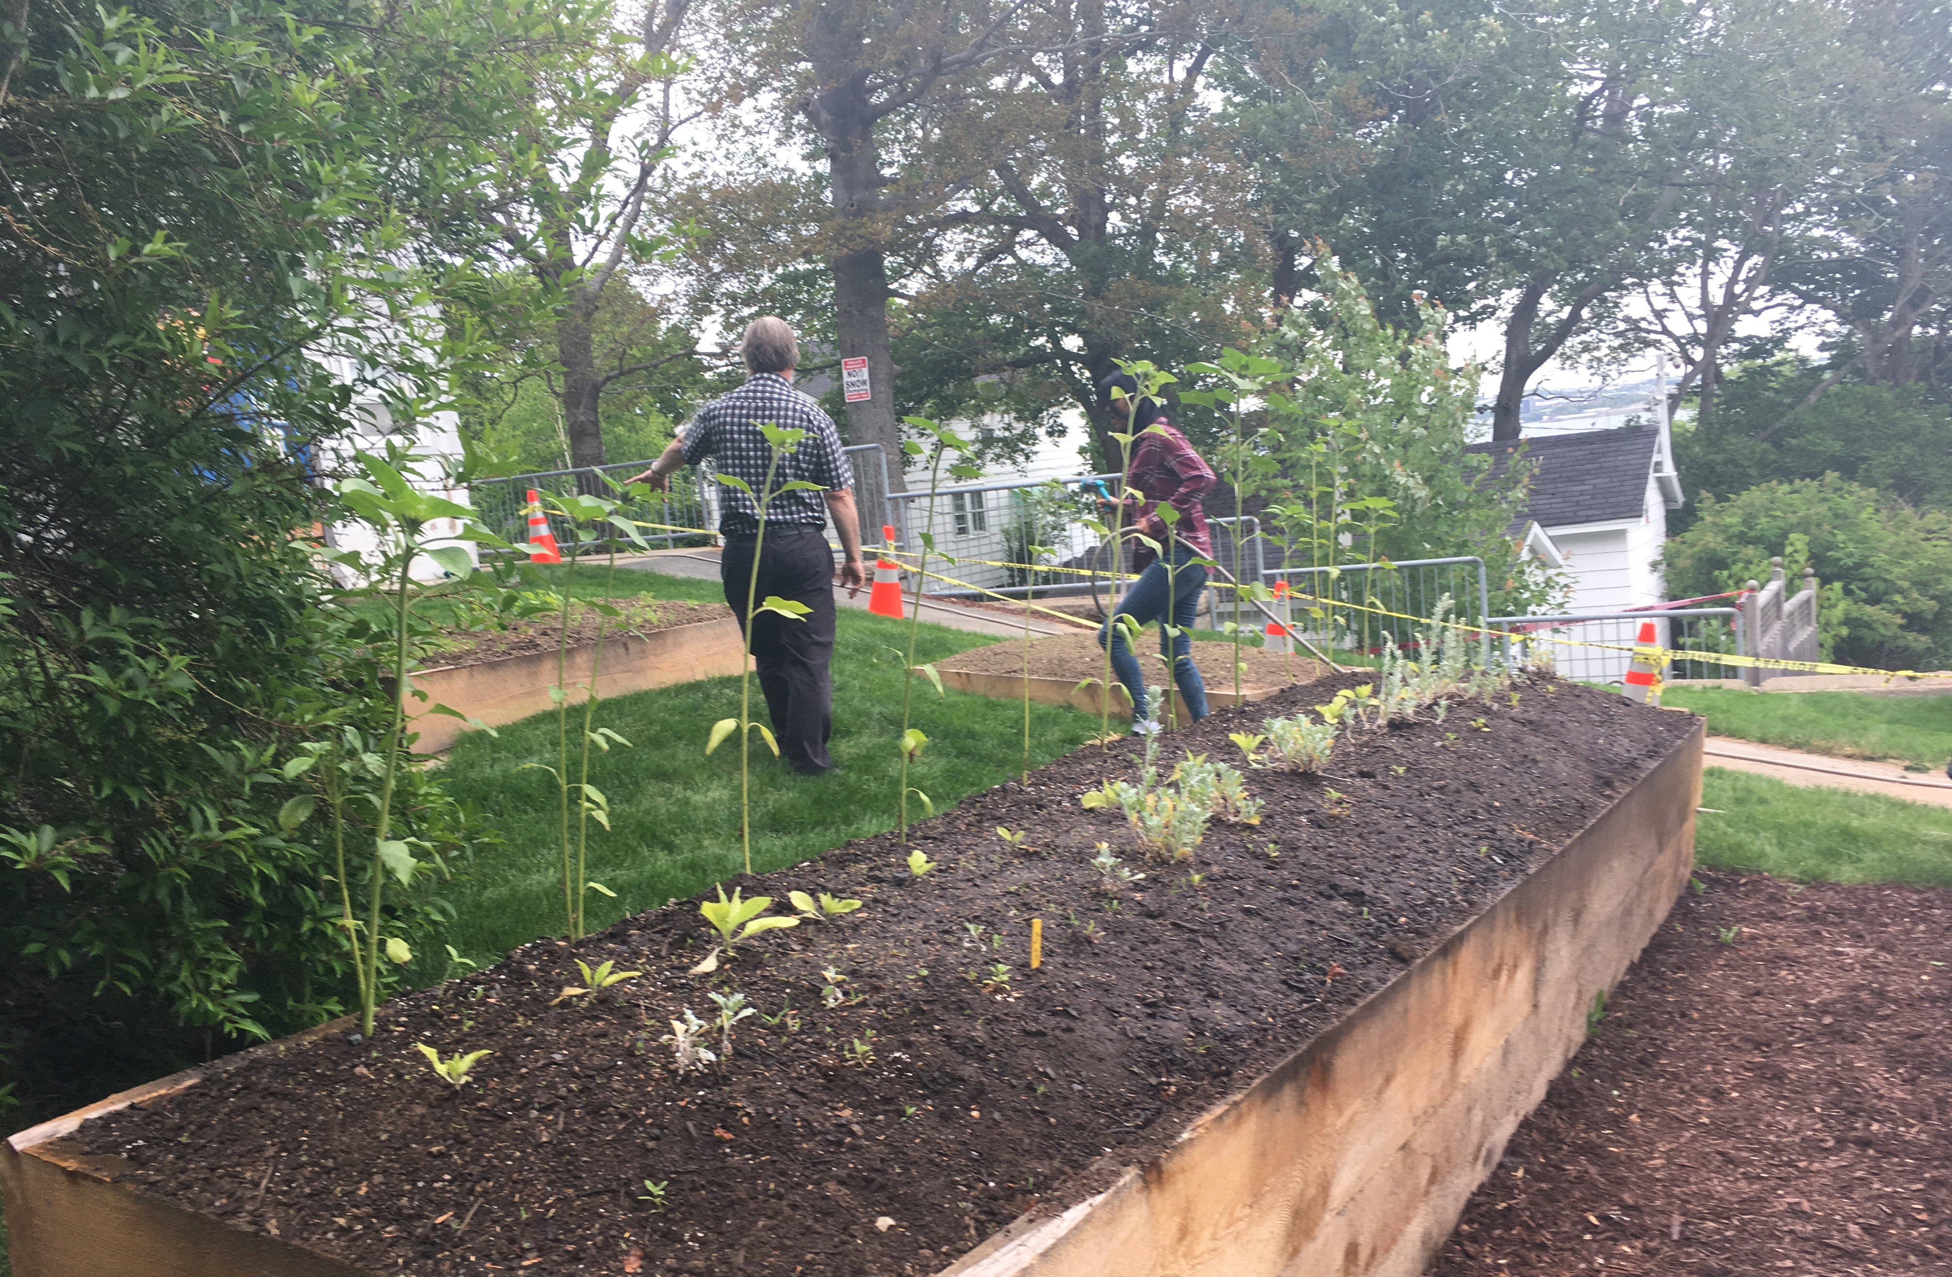
Key Concepts
Relationship
Indigenous Ally/Allyship
Experiential Learning
Truth and Reconciliation
Community Gardening and Scholarship
Listening more Speaking less

Slide 4
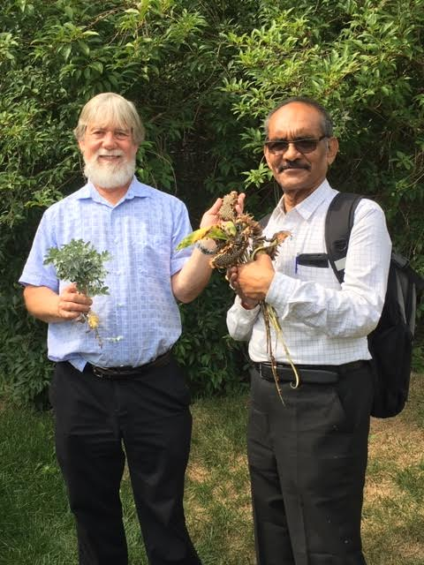
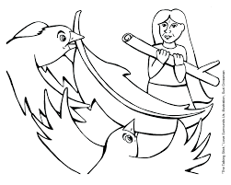
Talking circle
We would like your thoughts on how Indigenous community gardens can be used to build relationship between the Mi'kmaw and settlers and support Truth and Reconciliation Calls to Action.

Slide 5
References
Archibald, J. A. (2008). Indigenous storywork: Educating the heart, mind, body, and spirit. UBC press.
Battiste, M. A. (Ed.). (2016). Visioning a Mi'kmaw Humanities: Indigenizing the Academy. Cape Breton University Press.
Battiste, M. (Ed.). (2016). Living Treaties: Narrating Mi'kmaw Treaty Relations. Cape Breton University Press.
Battiste, M. (2013). Decolonizing education: Nourishing the learning spirit. UBC Press.
Bishop, A. (2002). Becoming an ally: Breaking the cycle of oppression in people. London: Zed Books.
Bartlett, C., Marshall, M., & Marshall, A. (2012). Two-eyed seeing and other lessons learned
within a co-learning journey of bringing together Indigenous and mainstream knowledges and ways of knowing. Journal of Environmental Studies and Sciences, 2(4), 331-340.
Government of Canada. (2018). Delivering on truth and reconciliation commission: Calls to action. Retrieved from: https://www.aadnc-aandc.gc.ca/eng/1524494530110/1524494579700
Regan, P. (2010). Unsettling the Setters within: Indian residential school, truth telling, and reconciliation in Canada. Toronto. UBC Press.
Smith, L. T. (2013). Decolonizing methodologies: Research and indigenous peoples. Zed Books Ltd.
Vowel, C. (2016). Indigenous writes: A guide to First Nations, Métis, and Inuit issues in Canada. Portage & Main Press.
Wilson, S. (2008). Research is ceremony: Indigenous research methods. Halifax: Fernwood.
Younging, G. (2018). Elements of Indigenous Style: A Guide for Writing by and about Indigenous Peoples. Brush Education.

