Slide 1
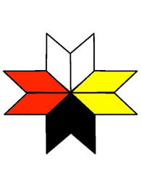
How can the Practice of Indigenous Allyship support Socially Just Narratives Among the Mi’kmaq and Settlers?
Elder Joe Michael
Margaret JA Knickle
PhD Student
MSVU
November 2018

Slide 2
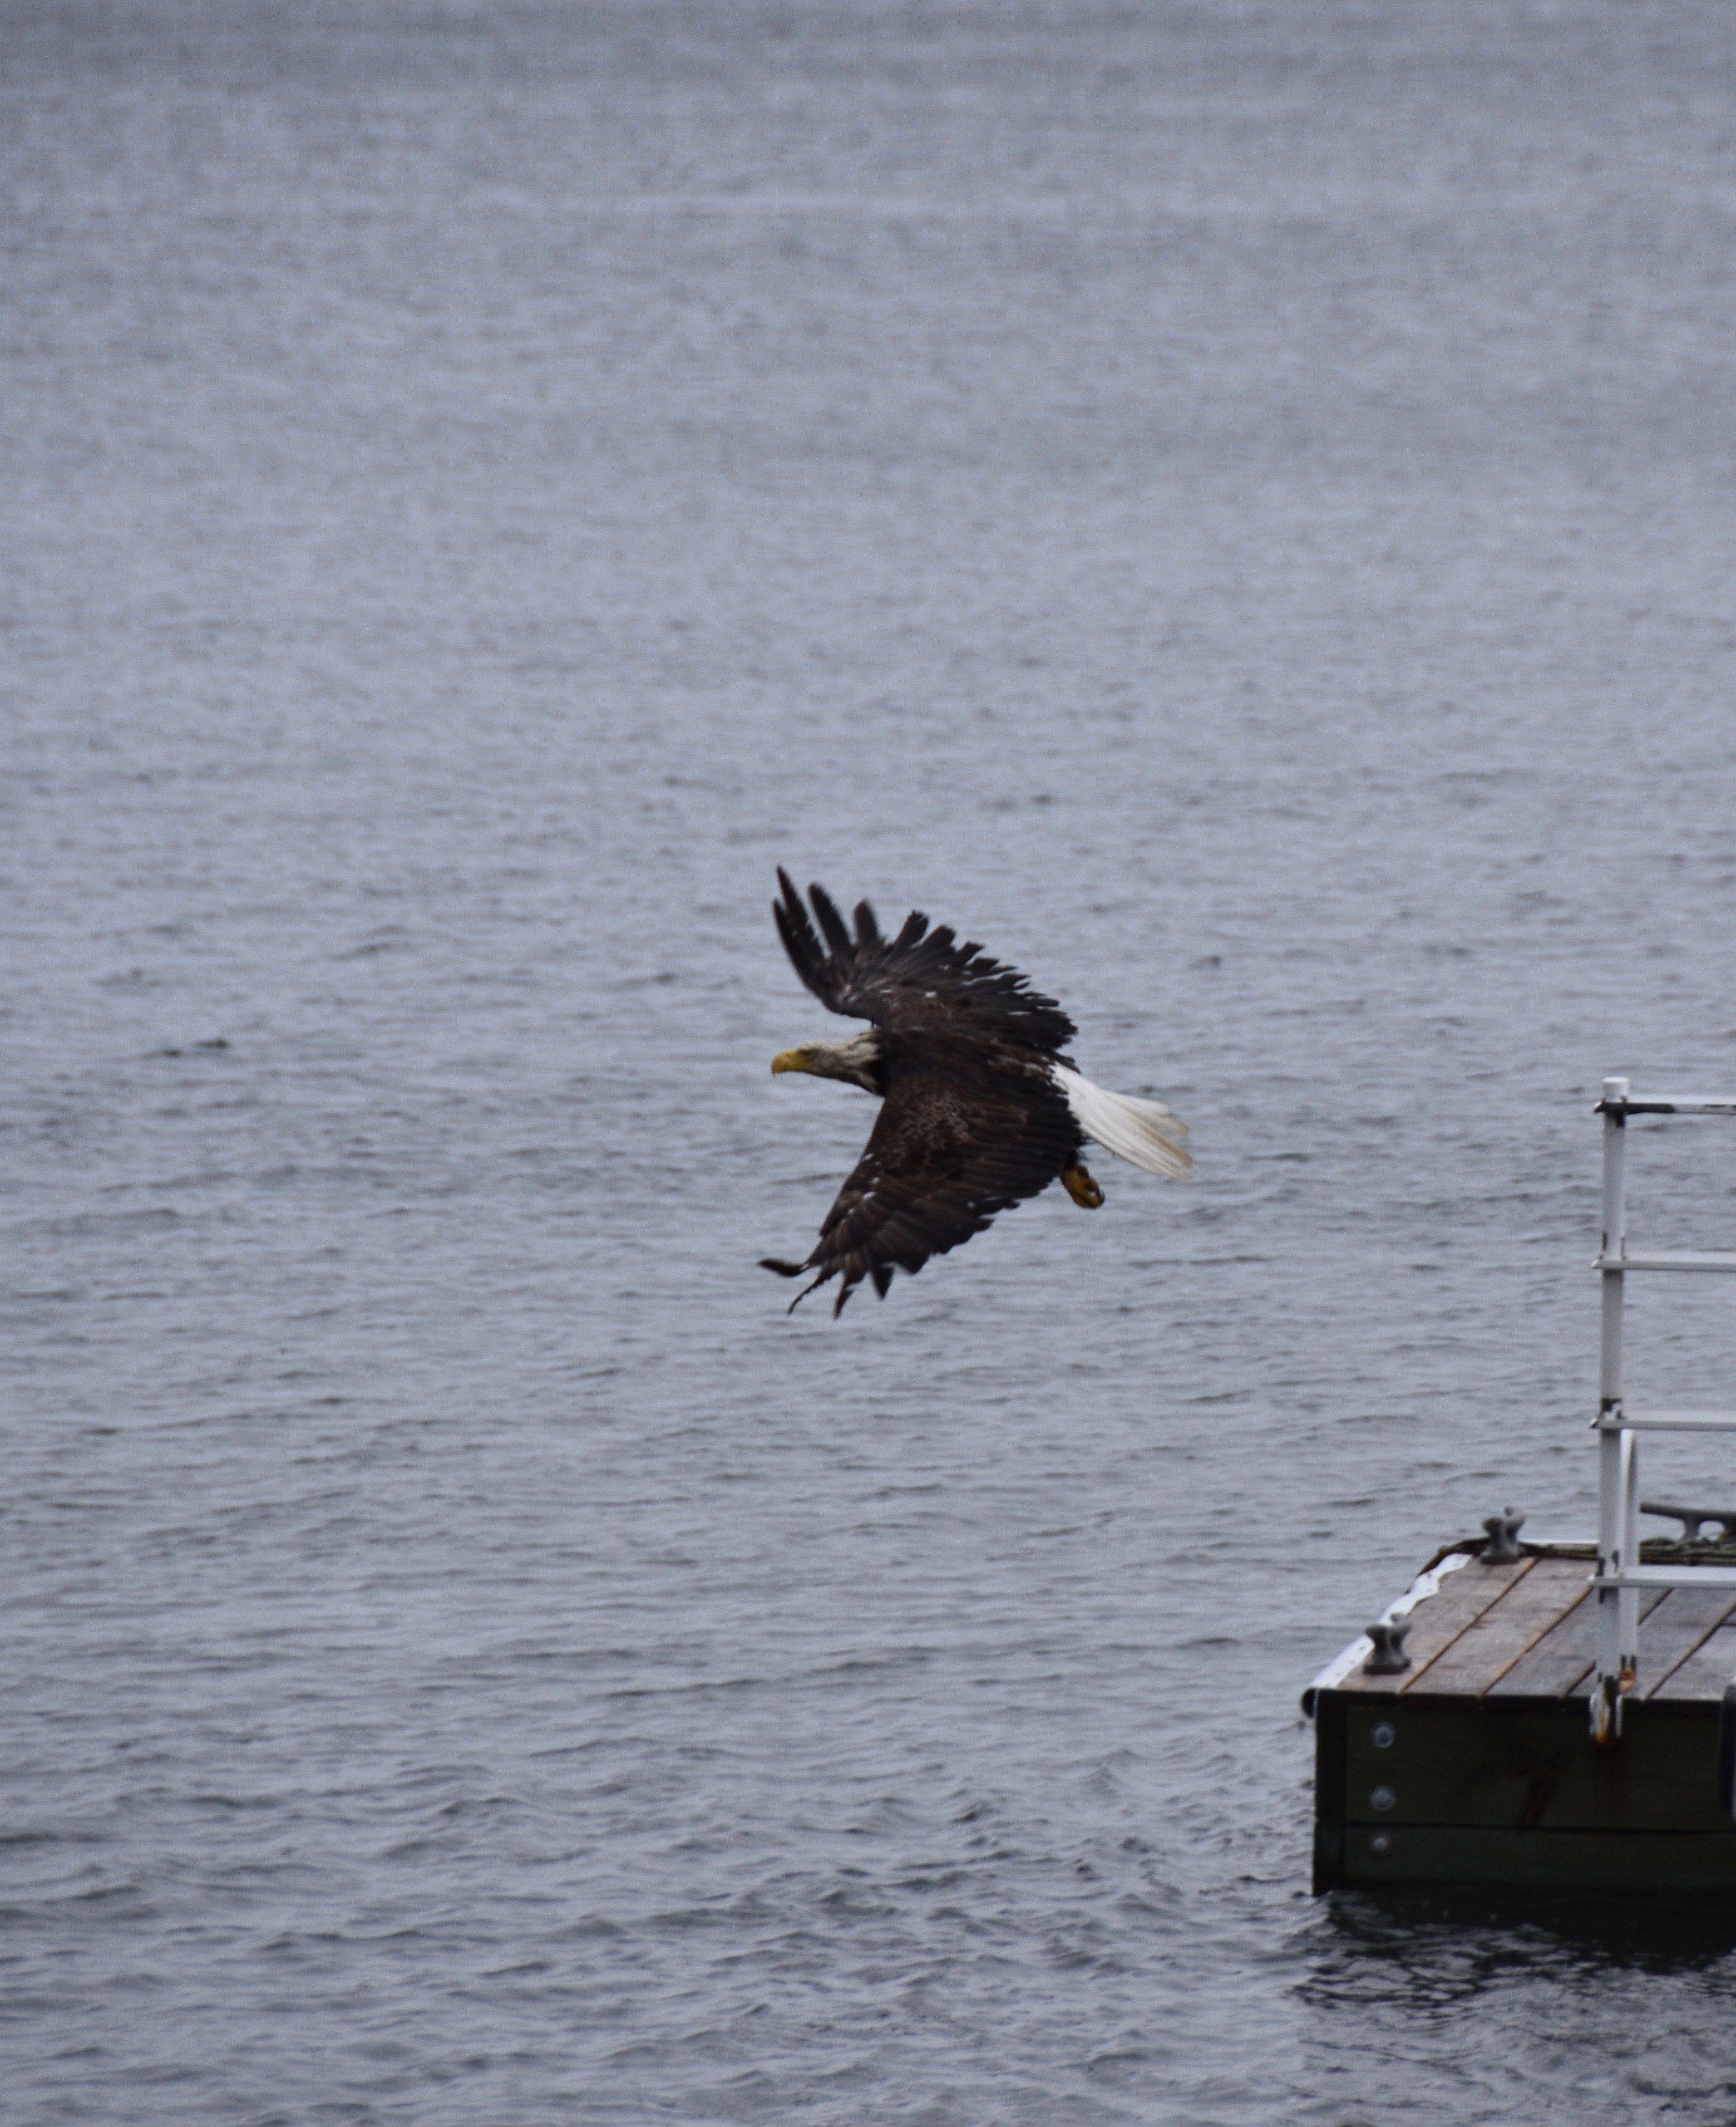
Kwe’
Greetings from the East from the Mi’kmaw territory.
Thankyou for allowing us into your territory!
Wela’lin!!
Miigwech !!

Slide 3
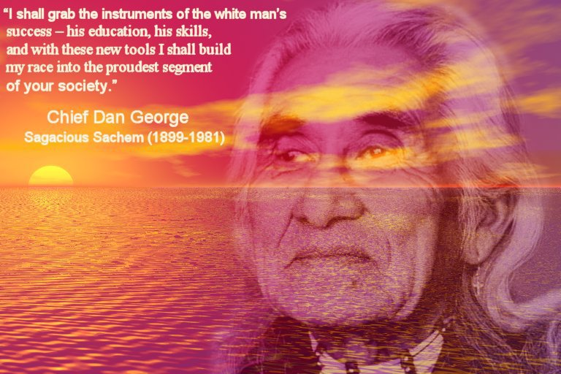

Slide 4
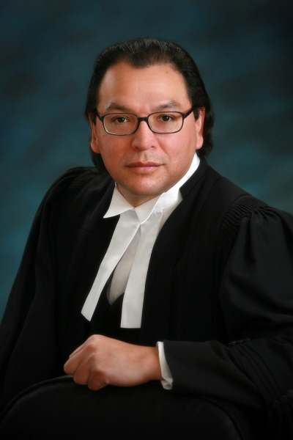
James Michael
First Mi’kmaq to be admitted to the Nova Scotia Bar
His picture hangs in the Supreme Court of Nova Scotia

Slide 5
Two eyed seeing (Etuaptmumk)
Learning to see from one eye with the strengths of Indigenous knowledges and ways of knowing
Learning from the other eye with the strengths of Western knowledges and ways of knowing
Learning to use both these eyes together, for the benefit of all
Murdina & Albert Marshall

Slide 6
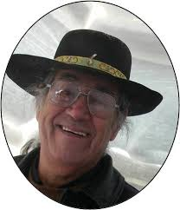
How do we Indigenize the Academy
Elders attend and co present with settler in academic settings
Making an Elder a priority in Research process
Privileging the voice of Elders at conferences
Honouring the lifelong experiences from an Elders teachings

Slide 7
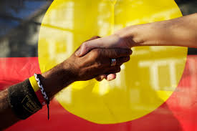
How to practice Indigenous allyship?
Build genuine relationships and friendship
Recognizing one’s settler privilege
Be informed about the historical, socio-political context that frames our interactions with the Mi’kmaq
Not one’s identity but it is an action take collectively
Recognize Mi’kmaw leaders and respect their authority
Practice active listening
Work in solidarity for change
Practicing “Msit No’Kmaq” “All My Relations”

Slide 8

Awareness Test
Notes:
It is not what it seems to be but what you are being told.

Slide 9
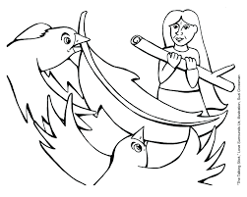
Talking CIRCLE and Discussion
What can you take away today that will nourish your learning spirit?

Slide 10
References
Archibald, J. A. (2008). Indigenous storywork: Educating the heart, mind, body, and spirit. UBC press.
Battiste, M. A. (Ed.). (2016). Visioning a Mi'kmaw Humanities: Indigenizing the Academy. Cape Breton University Press.
Battiste, M. (Ed.). (2016). Living Treaties: Narrating Mi'kmaw Treaty Relations. Cape Breton University Press.
Battiste, M. (2013). Decolonizing education: Nourishing the learning spirit. UBC Press.
Bishop, A. (2002). Becoming an ally: Breaking the cycle of oppression in people. London: Zed Books.
Bartlett, C., Marshall, M., & Marshall, A. (2012). Two-eyed seeing and other lessons learned
within a co-learning journey of bringing together Indigenous and mainstream knowledges and ways of knowing. Journal of Environmental Studies and Sciences, 2(4), 331-340.
Government of Canada. (2018). Delivering on truth and reconciliation commission: Calls to action. Retrieved from: https://www.aadnc-aandc.gc.ca/eng/1524494530110/1524494579700
Regan, P. (2010). Unsettling the Setters within: Indian residential school, truth telling, and reconciliation in Canada. Toronto. UBC Press.
Smith, L. T. (2013). Decolonizing methodologies: Research and indigenous peoples. Zed Books Ltd.
Vowel, C. (2016). Indigenous writes: A guide to First Nations, Métis, and Inuit issues in Canada. Portage & Main Press.
Wilson, S. (2008). Research is ceremony: Indigenous research methods. Halifax: Fernwood.
Younging, G. (2018). Elements of Indigenous Style: A Guide for Writing by and about Indigenous Peoples. Brush Education.

